Slide 1
Assessing Maternal Health Risk using ML
health care

Slide 2

Facts
A maternal death occurred almost every two minutes in 2020
Every day in 2020, almost 800 women died from preventable causes related to pregnancy and childbirth.

Slide 3
Objective
The objective is to build classification model that can accurately classify pregnant women into different risk categories, such as low, medium, and high risk.

Slide 4
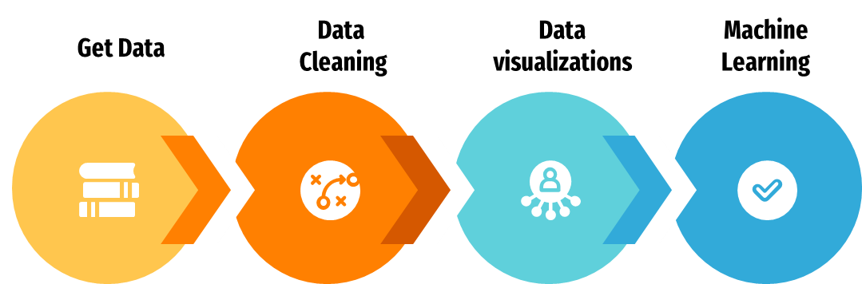
Steps

Slide 5
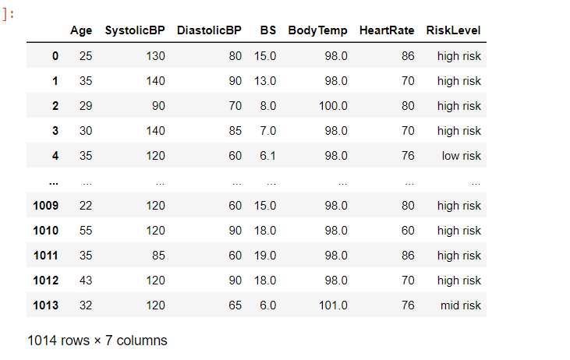

Slide 6
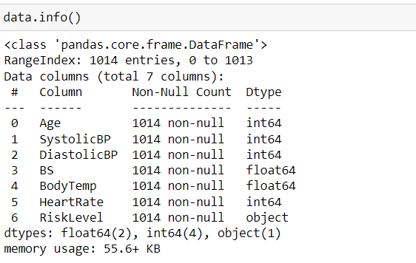
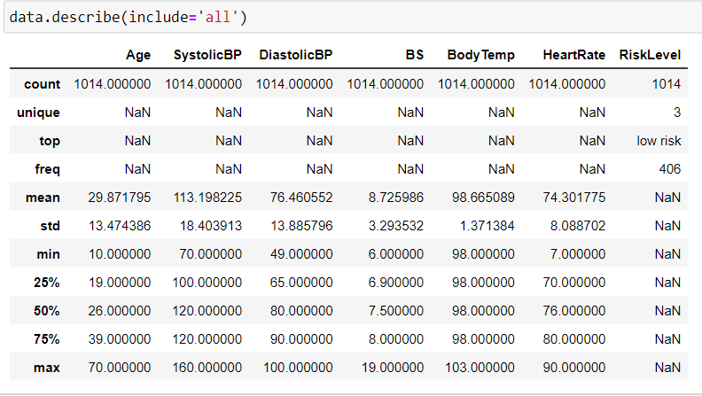

Slide 7
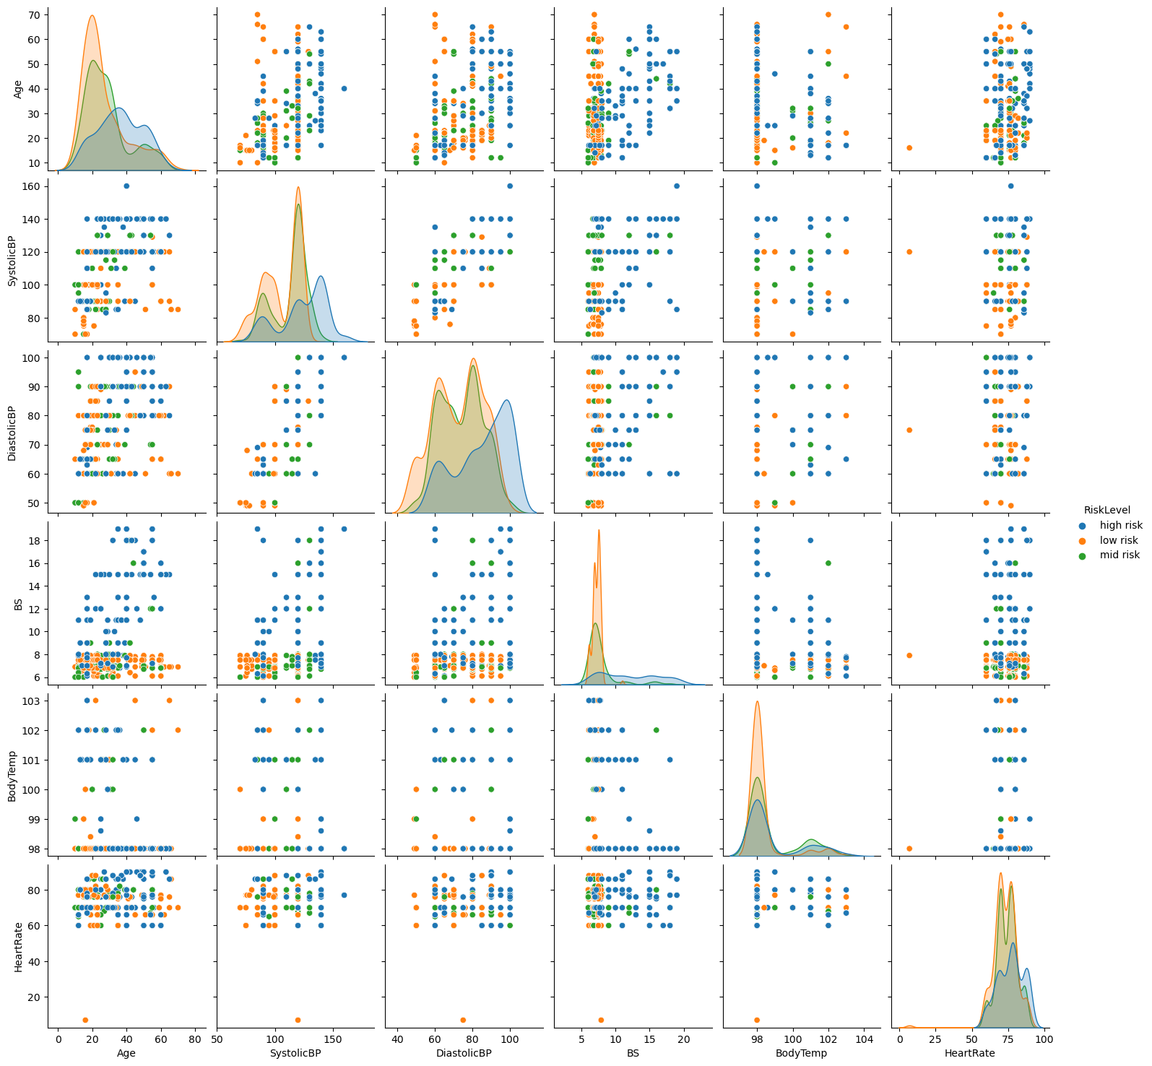

Slide 8
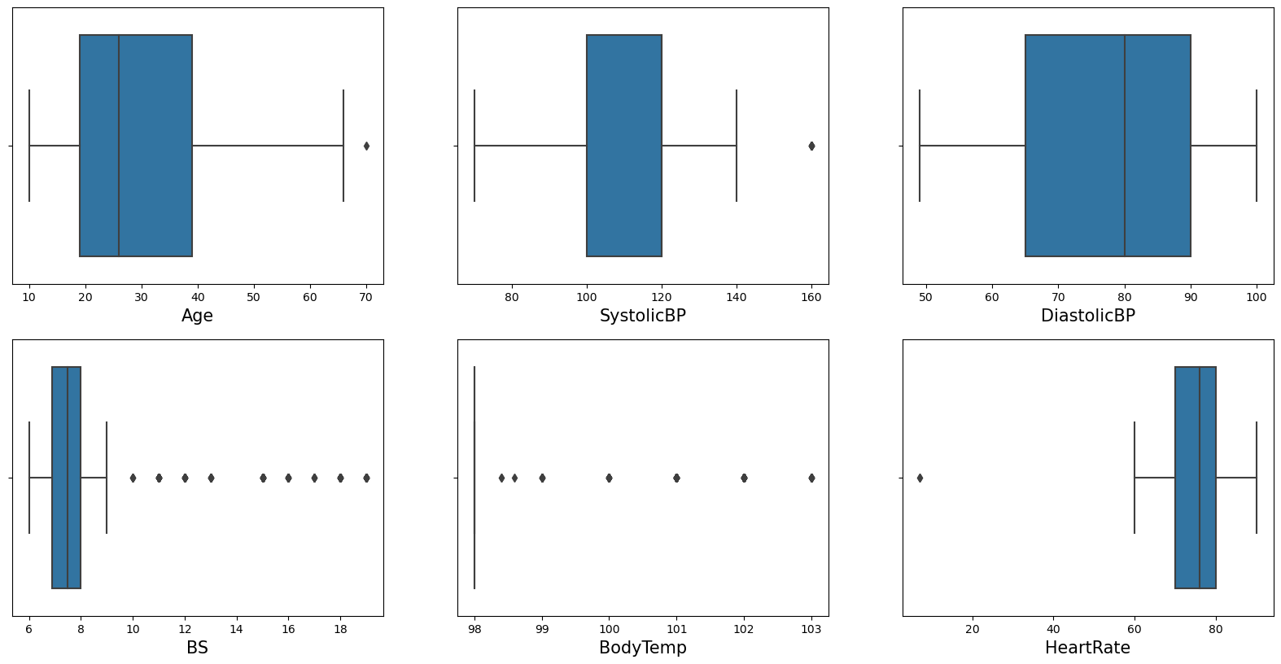

Slide 9
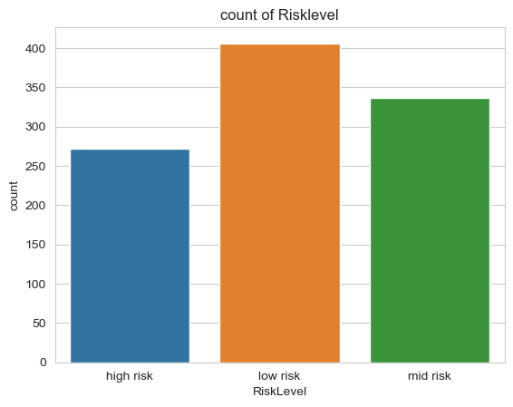

Slide 10
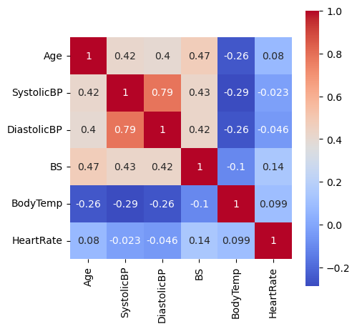

Slide 11
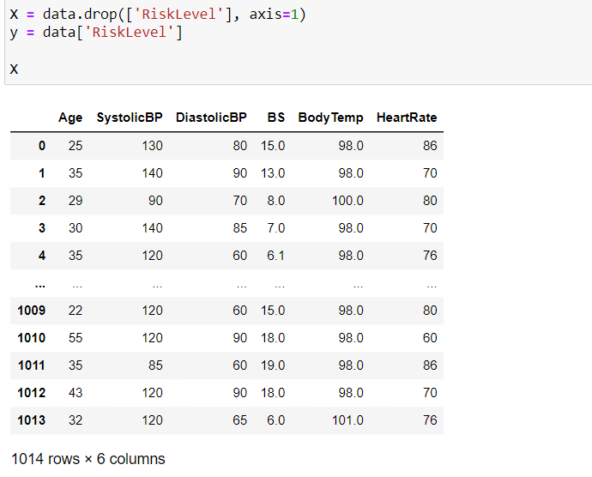
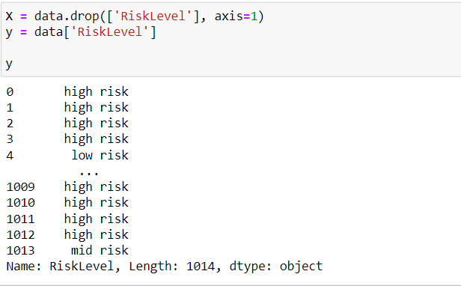
Modelling

Slide 12
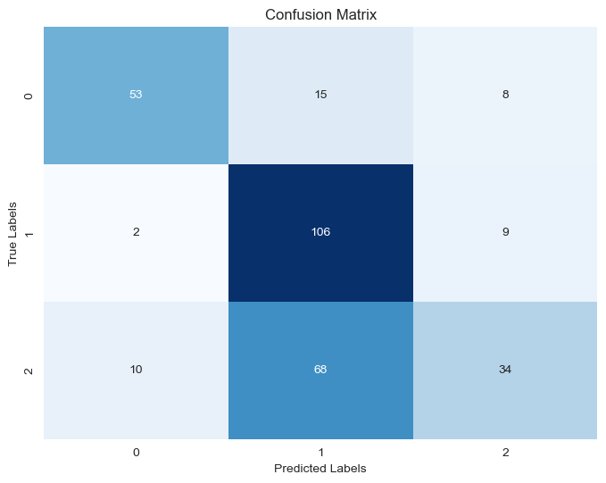
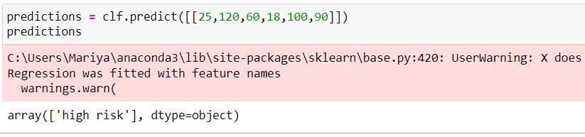
LogisticRegression

Slide 13
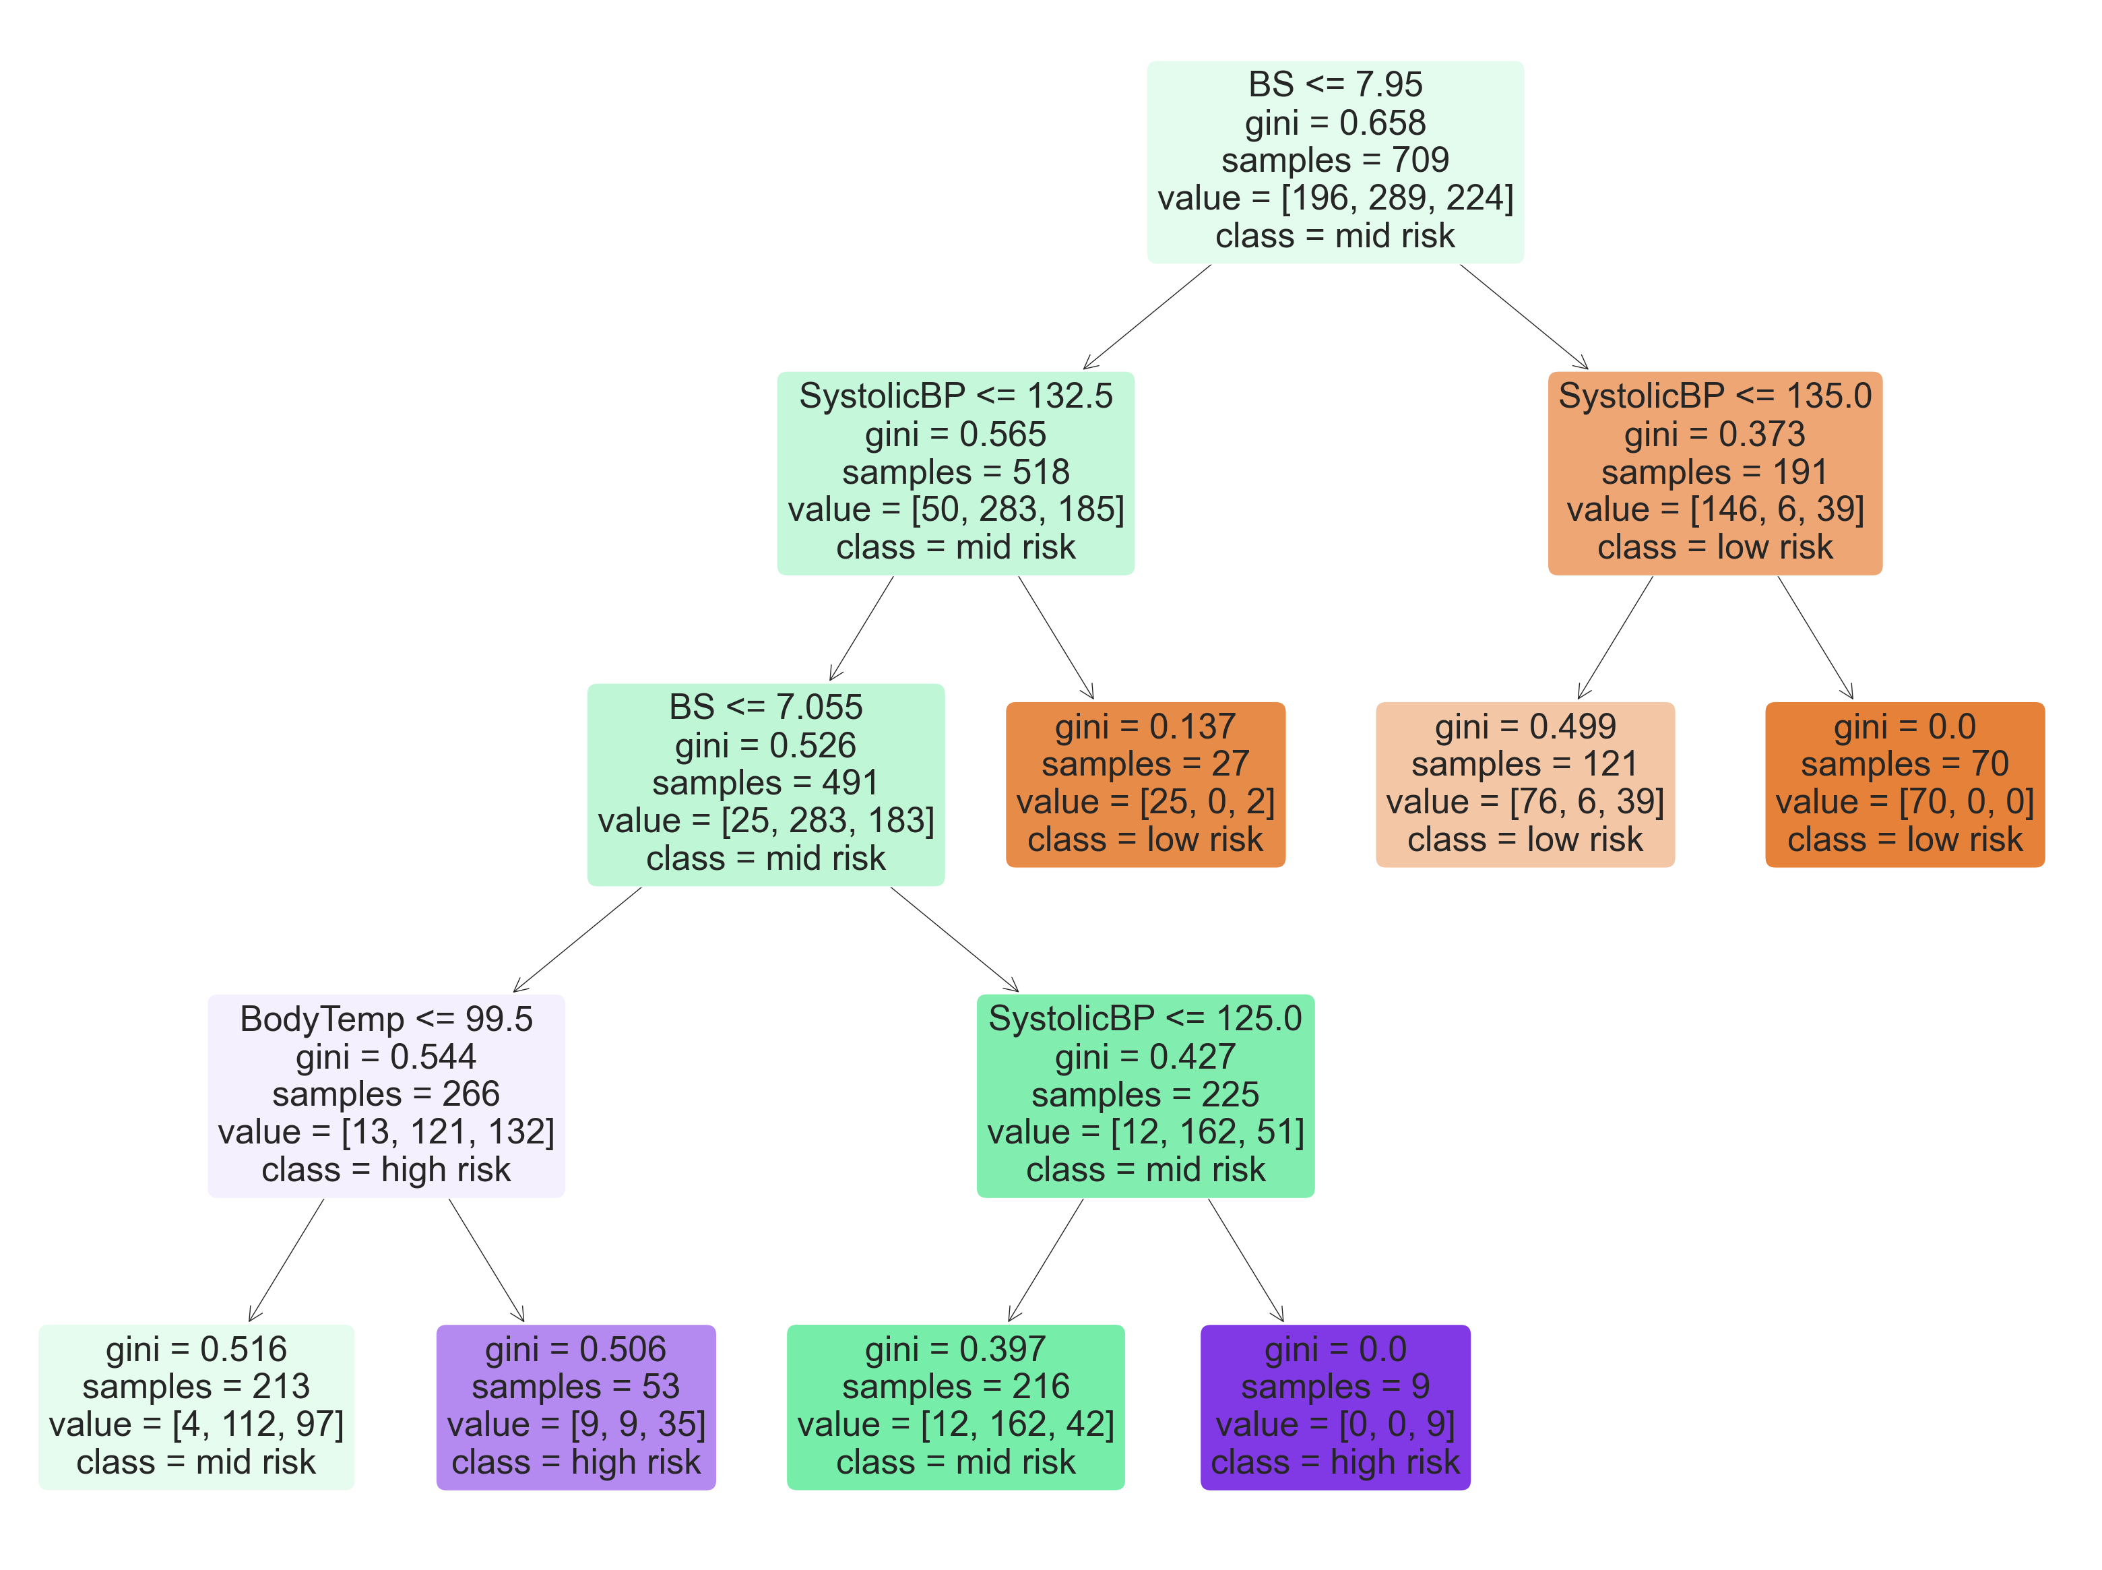
Decision Tree

Slide 14
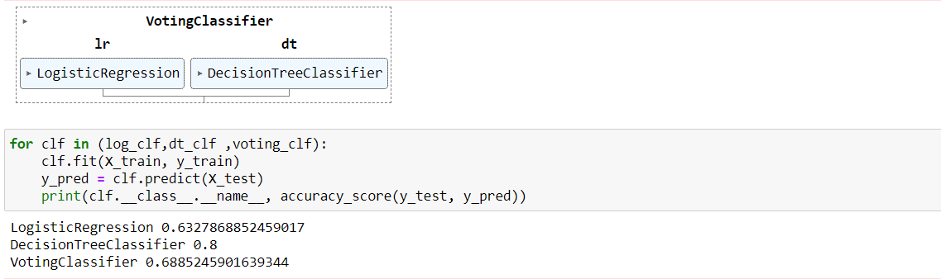
Ensamble ml_voting

Slide 15
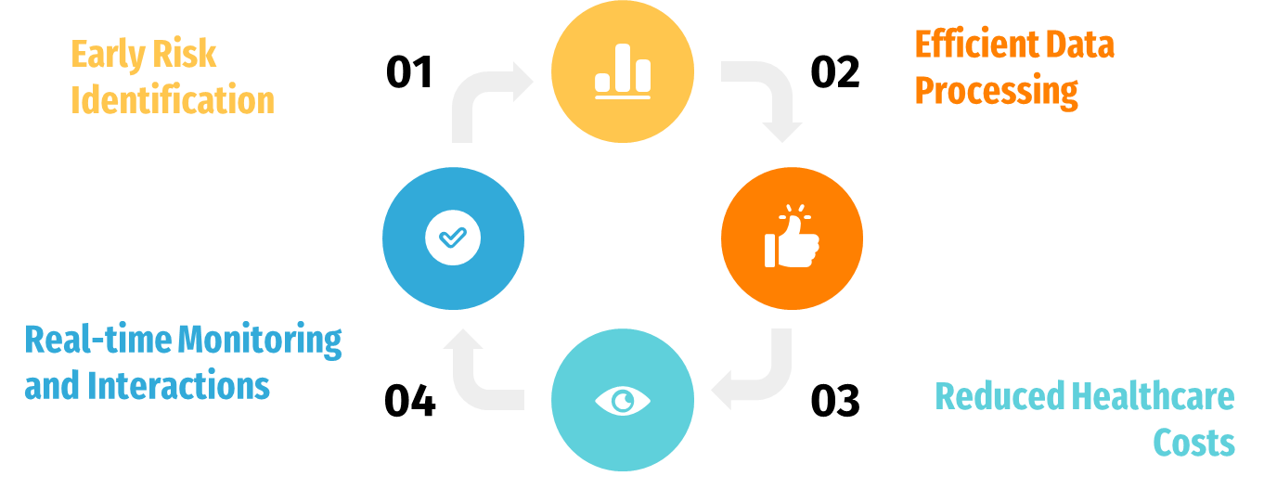
Benefits of using modelling

Slide 16
Thank you

